Slide 1
Overview of Agile Methodology
Notes:
This template can be used as a starter file for presenting training materials in a group setting.
Sections
Right-click on a slide to add sections. Sections can help to organize your slides or facilitate collaboration between multiple authors.
Notes
Use the Notes section for delivery notes or to provide additional details for the audience. View these notes in Presentation View during your presentation.
Keep in mind the font size (important for accessibility, visibility, videotaping, and online production)
Coordinated colors
Pay particular attention to the graphs, charts, and text boxes.
Consider that attendees will print in black and white or grayscale. Run a test print to make sure your colors work when printed in pure black and white and grayscale.
Graphics, tables, and graphs
Keep it simple: If possible, use consistent, non-distracting styles and colors.
Label all graphs and tables.

Slide 2
Objectives
Software development processes
  Water Fall Model
  Agile Model

Slide 3
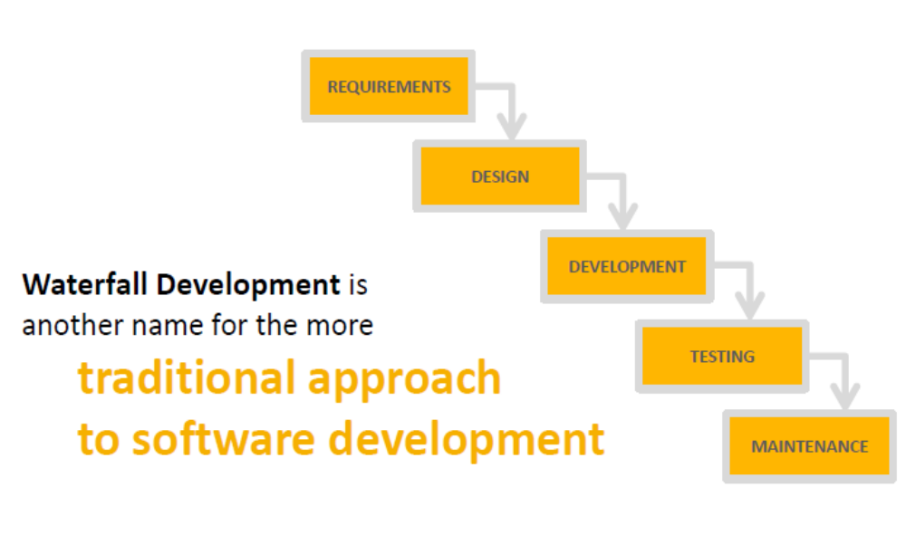
Waterfall Development

Slide 4
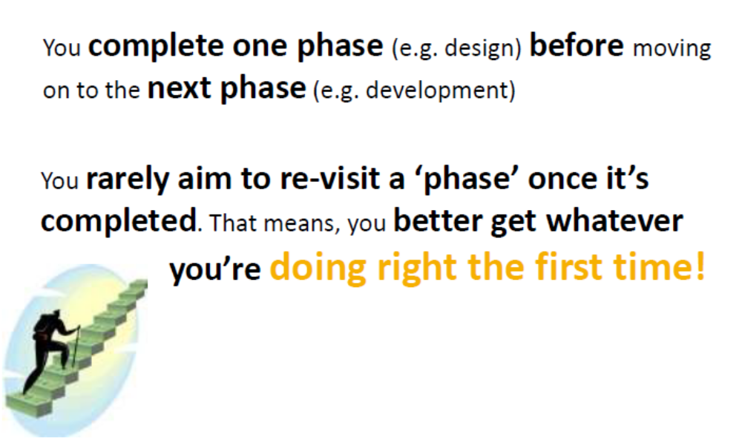
Waterfall Development

Slide 5
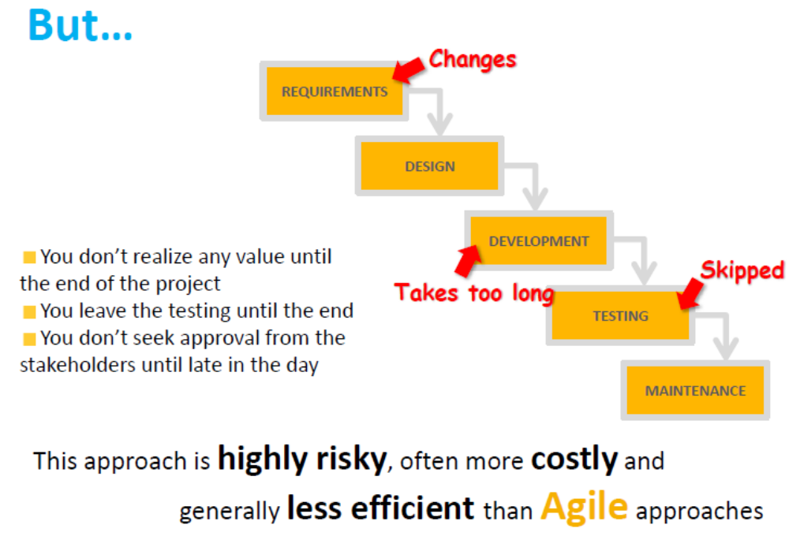

Slide 6
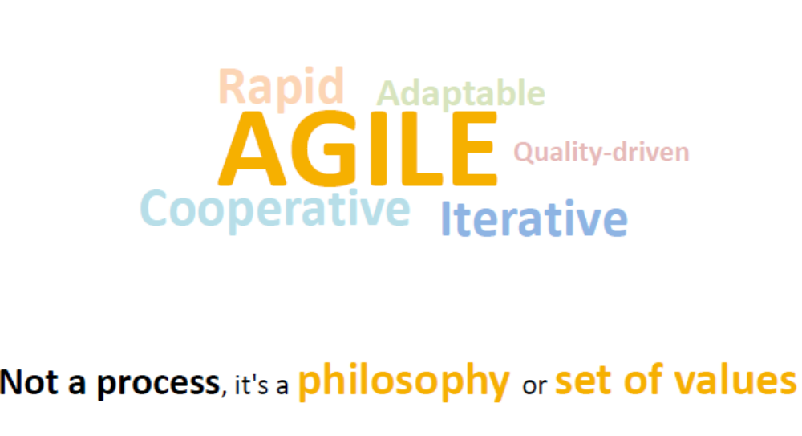
Agile

Slide 7
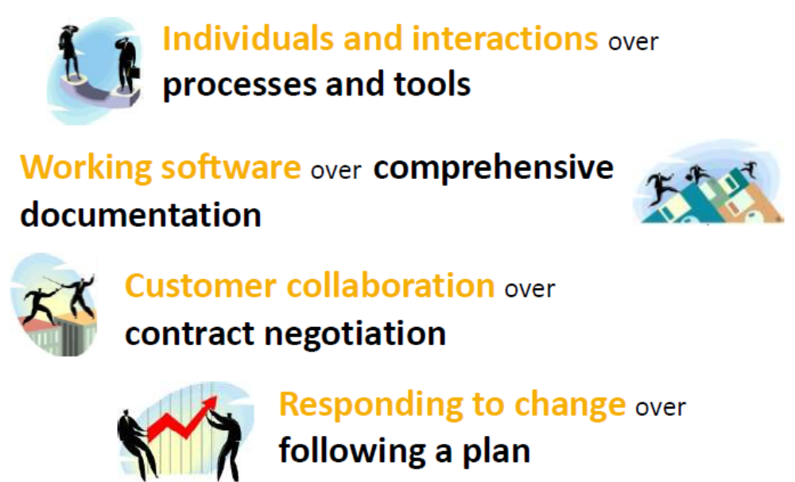
Agile Manifesto

Slide 8
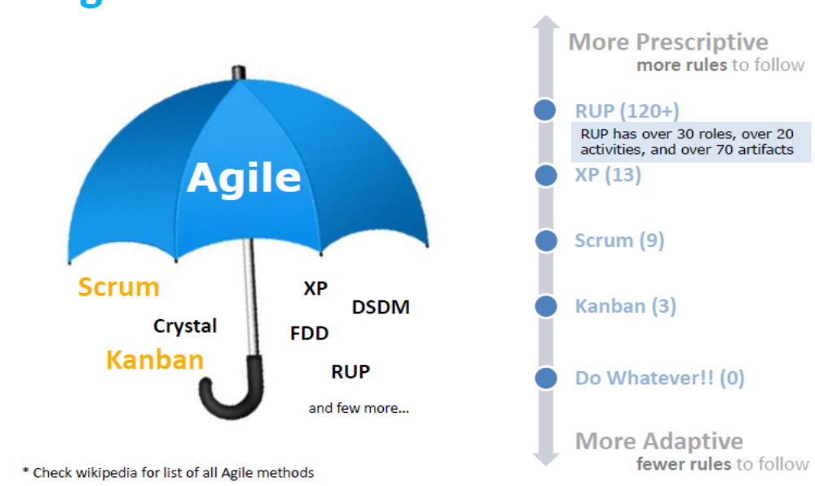
Agile Umbrella

Slide 9
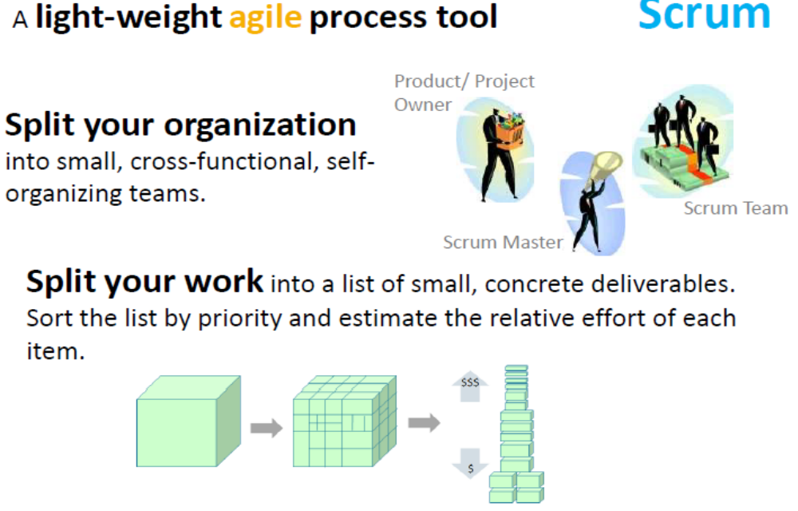
Scrum

Slide 10
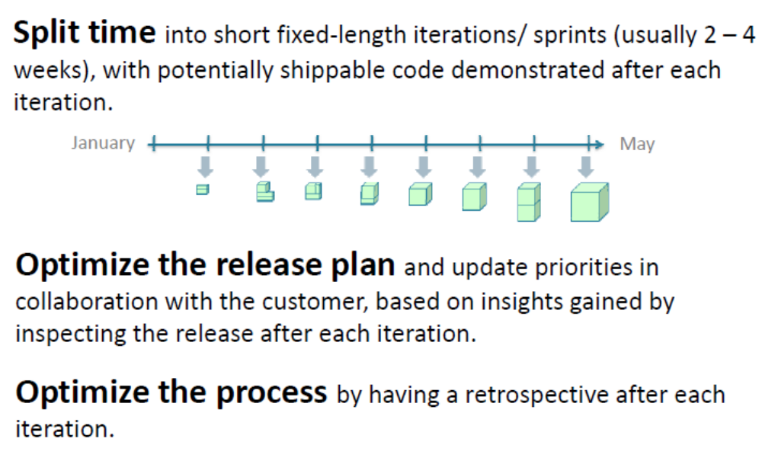
Agile - Planning

Slide 11
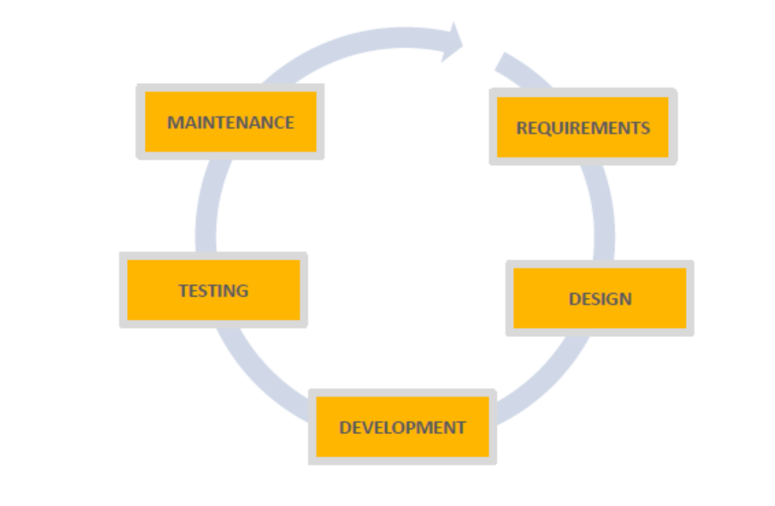
Scrum vs Waterfall

Slide 12
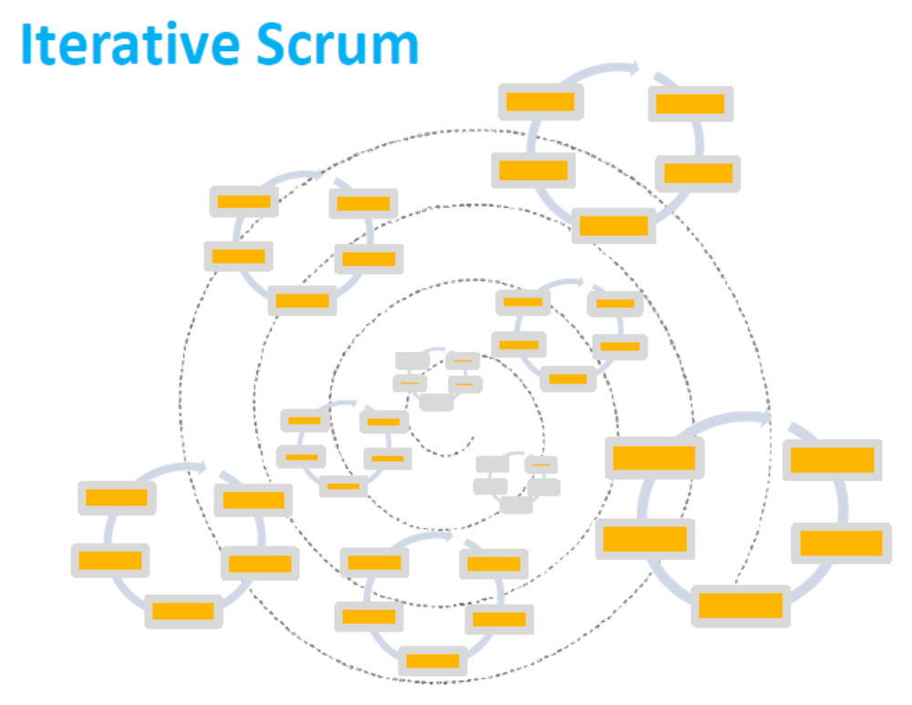

Slide 13
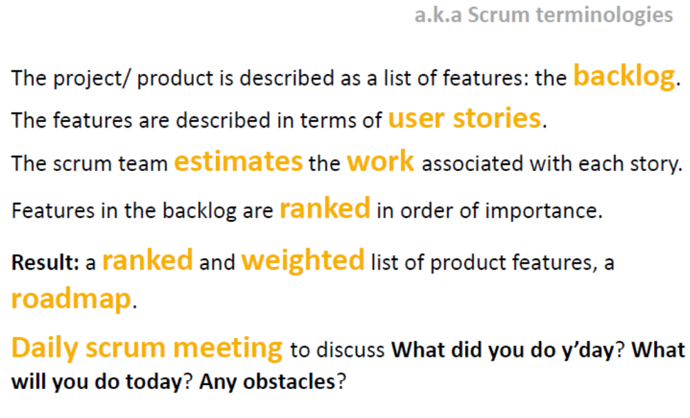
Things we do in Scrum

Slide 14
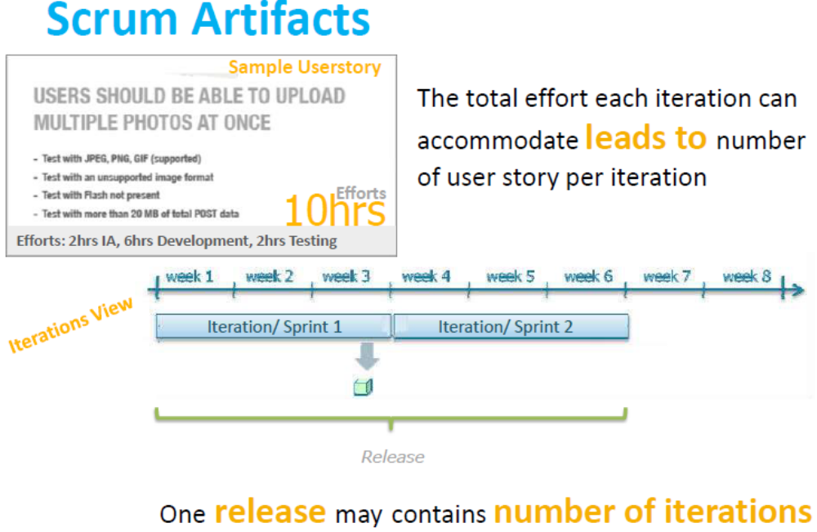

Slide 15
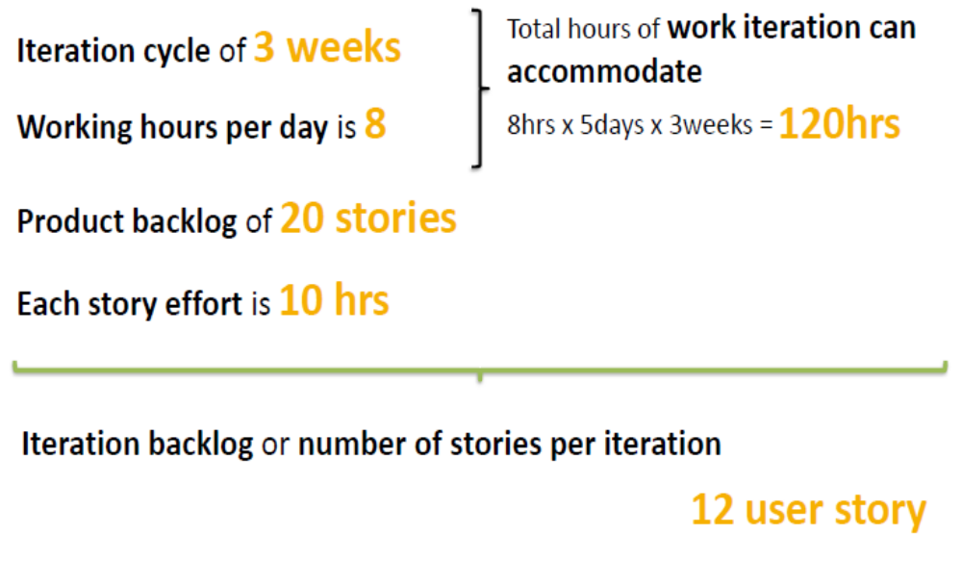
Scrum Planning Example

Slide 16
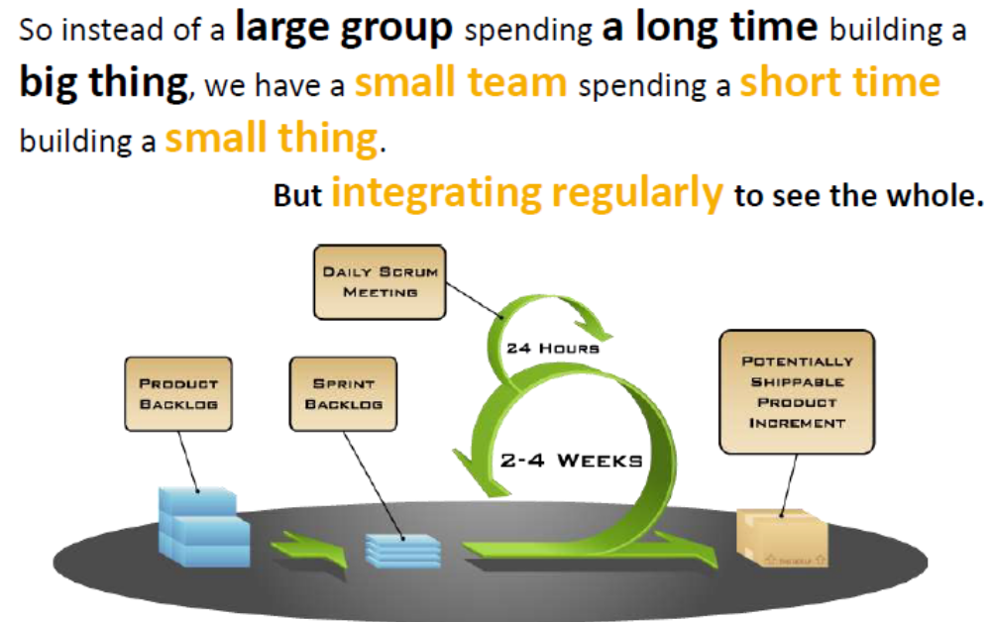
Scrum in a Nut Shell

Slide 17
Thank You

